Slide 1

Meta-Learning for AutoML Warm-Start
Maria Širai
Ülle Püttsepp
Project 1, AutoML course, 24.11.2025
#UniTartuCS

Slide 2
Problem statement
Build a meta-learning model to predict the best-performing time-series forecasting algorithm from a knowledge base containing datasets standard description paragraphs of the dataset meta-features in addition to the best forecasting algorithm label and its hyper-parameter set

Slide 3
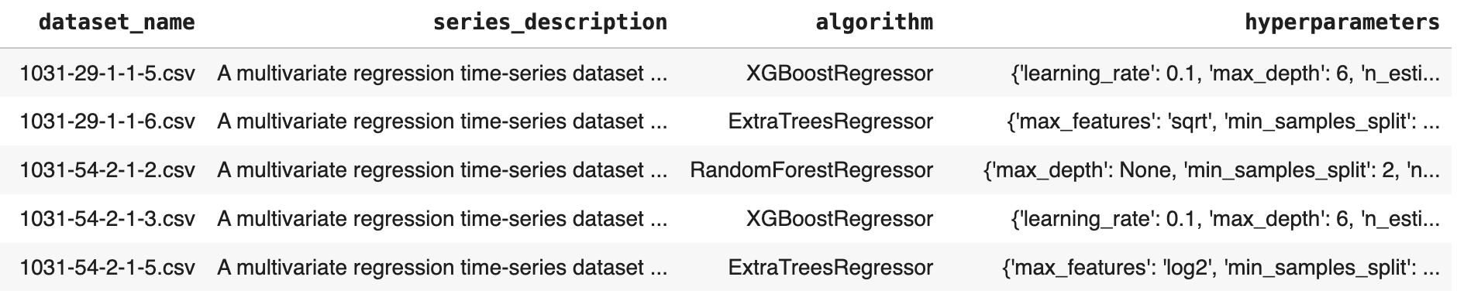
Knowledgebase dataset
Target: algorithm

Slide 4
series_description example
A multivariate regression time-series dataset consists of 7464 instances and 17 features. The percentage of numerical features to categorical features in the dataset is 2.2 The dataset has a sampling rate of 60.0 minutes. The percentage of missing values in the target column is 0.19%. he missing values percentages for numerical features range from 1400% to 211200% with mean 20472.73%, and standard deviation 63257.08%.Similarly, the missing values percentages for categorical features range from 1400% to 1400% with mean 1400.0%, and standard deviation 0.0%. The target series has a minimum value 19.9, maximum value 35.1, median 25.2, mean 26.153865275372308, and average standard deviation of 0.2014286746341122 for the 10 percentiles. The series is detected as stationary using dickey fuller test . The series has 10 significant lags observed using the partial autocorrelation function (pACF), the pACF values for these 10 lags ranges from 0.9366106168100137 for the lag number 1 to -0.06504818948904233 for the lag number 10.There are no insignificant lags in between the first and the last significant ones. The series looks to be a multiplicative time-series with a linear trend. There are no seasonality components detected in the series The series exhibits a skewness value of 0.48865133828757656 and a kurtosis value of 0.9848846069793469. The Fractal dimension analysis yields a value of -0.14743510177012986, indicating a Complex and irregular time-series structure. Among the numerical predictors, the series has 100.0% of the numerical features detected as stationary. There are no seasonality components detected in the numerical predictors. the numerical predictors also exhibit skewness values ranging from 0.07033260488392569 to 10.11096125923628, and kurtosis values of 0.1776720055358174 to 126.12768307338887. The fractal dimension analysis yields values ranging from -0.8385254825713919 to -0.08897767522391264 indicating a Complex and irregular time-series structure for the numerical predictors. The correlation values among the numerical predictors have a minimum of -0.33919535905860904, maximum 1.0, mean 0.19137572897846422, and standard deviation 0.428530520138784. Among the categorical predictors, the count of symbols ranges from 57 to 73 with a minimum entropy value 4.880777622397733, maximum entropy 5.320829081033635, mean 5.129391802964169, and standard deviation 0.17116964780347563. The dataset is converted into a simple regression task by extracting the previously described features.
44 meta-features extracted

Slide 5
hyperparameters example
{'learning_rate': 0.1, 'max_depth': 6, 'n_estimators': 50, 'random_state': 42, 'subsample': 0.8}
hyperparameters column was dropped from the dataset because it was not needed for the classification task
No scores for the algorithm performance were provided, so model predicting best hyperparameter combination could not be developed

Slide 6
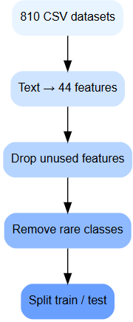
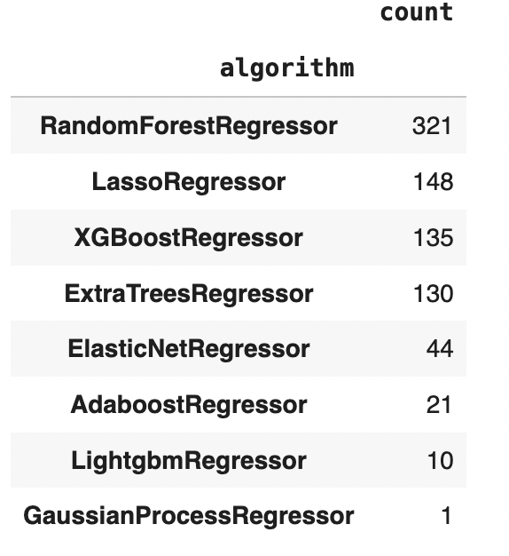
Data pre-processing steps
.csv (810 datasets as instances)
Converting series_description to tabular data (44 new features)
Dropping unnecessary features (dataset_name, hyperparameters, series_description)
Removing classes with
less than 2 observations
80/20% train and test split

Slide 7

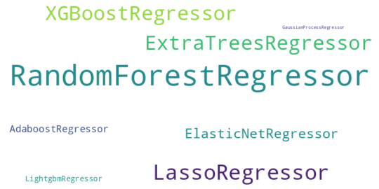
Random baseline
Random baseline was created by computing how frequently each class / algorithm appeared in the training set and converted those frequencies into class probabilities. Then those probabilities were used to randomly choose a class label for each test example, so more common classes were sampled more often.
Random baseline accuracy: 0.278
Random baseline F1 score: 0.181

Slide 8
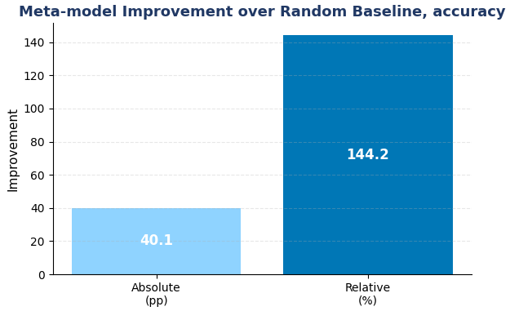
Random Forest meta-model for classification
Pre-processing steps for the model:
impute missing values with median for numeric features
impute missing values with “Unknown” category for categorical features
apply one-hot-encoding for categorical features
Train Random Forest classifier with balanced class weights
RandomForest accuracy: 0.679
RandomForest F1 score: 0.412
Random baseline accuracy: 0.278
Random baseline F1 score: 0.181

Slide 9
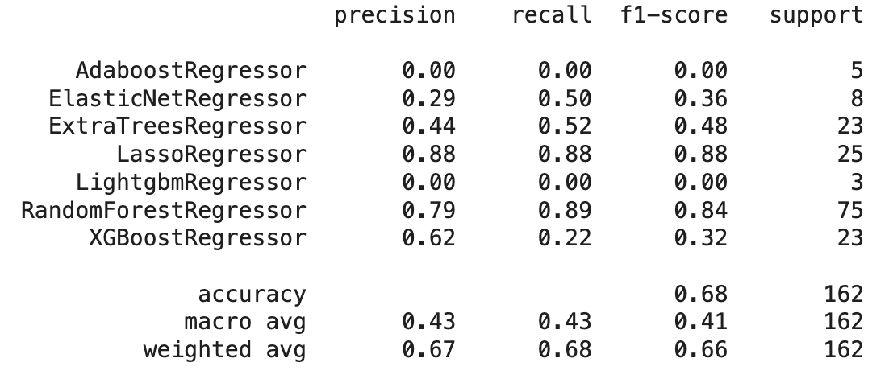
Classification report for Random Forest

Slide 10
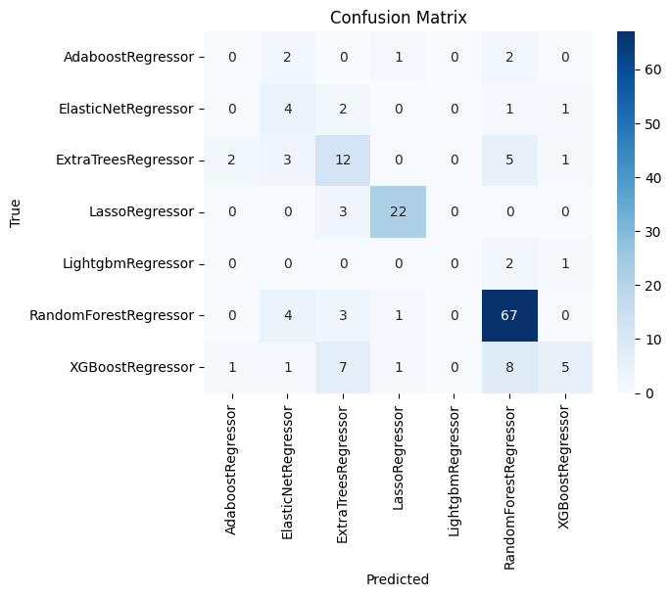

Slide 11
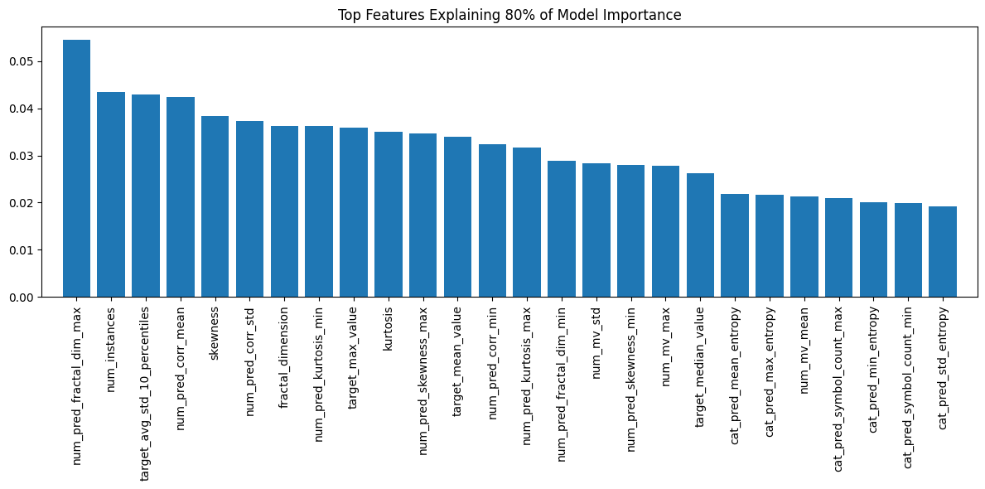
Feature importance
Notes:
num_pred_fractal_dim_max
Maximum fractal dimension observed across numerical predictor series.
num_instances
Total number of instances/rows in the dataset.
target_avg_std_10_percentiles
Average standard deviation across 10 percentile slices of the target distribution — captures variability consistency.
num_pred_corr_mean
Average pairwise correlation between numerical predictors.
skewness
Skewness of the target series — measures asymmetry in its distribution.
num_pred_corr_std
Standard deviation of correlation values among numerical predictors.

Slide 12
Thank you!

